Slide 1
SAFETY TRACKER
TEAM NAME: SPACE INSIDER

Slide 2
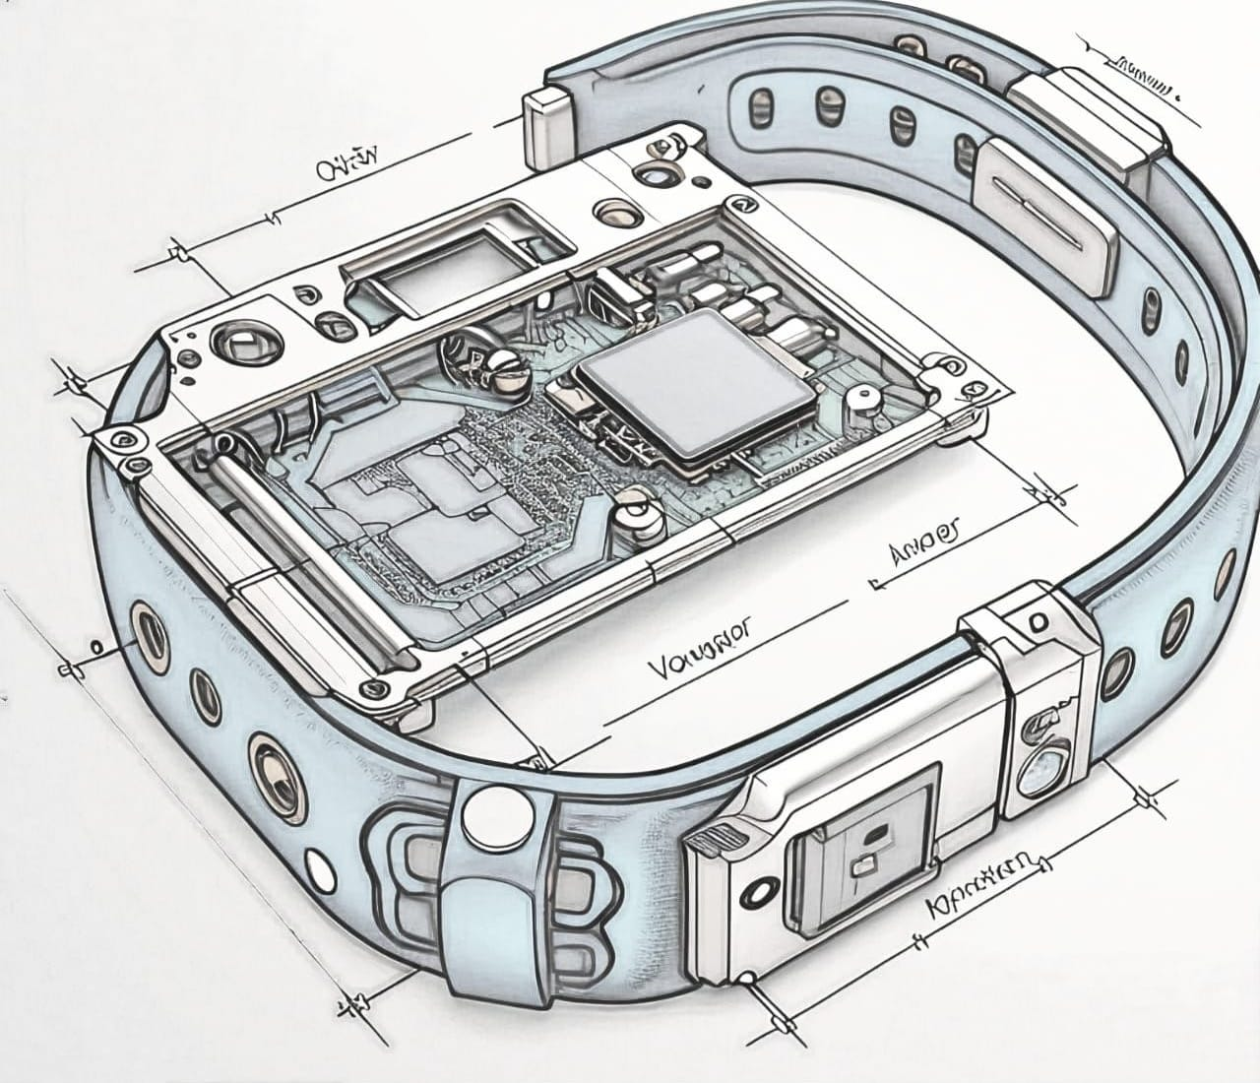
DETECTOR
SENSOR
GPS TRACKER
ACTIVATION SWITCH
WRIST BAND

Slide 3
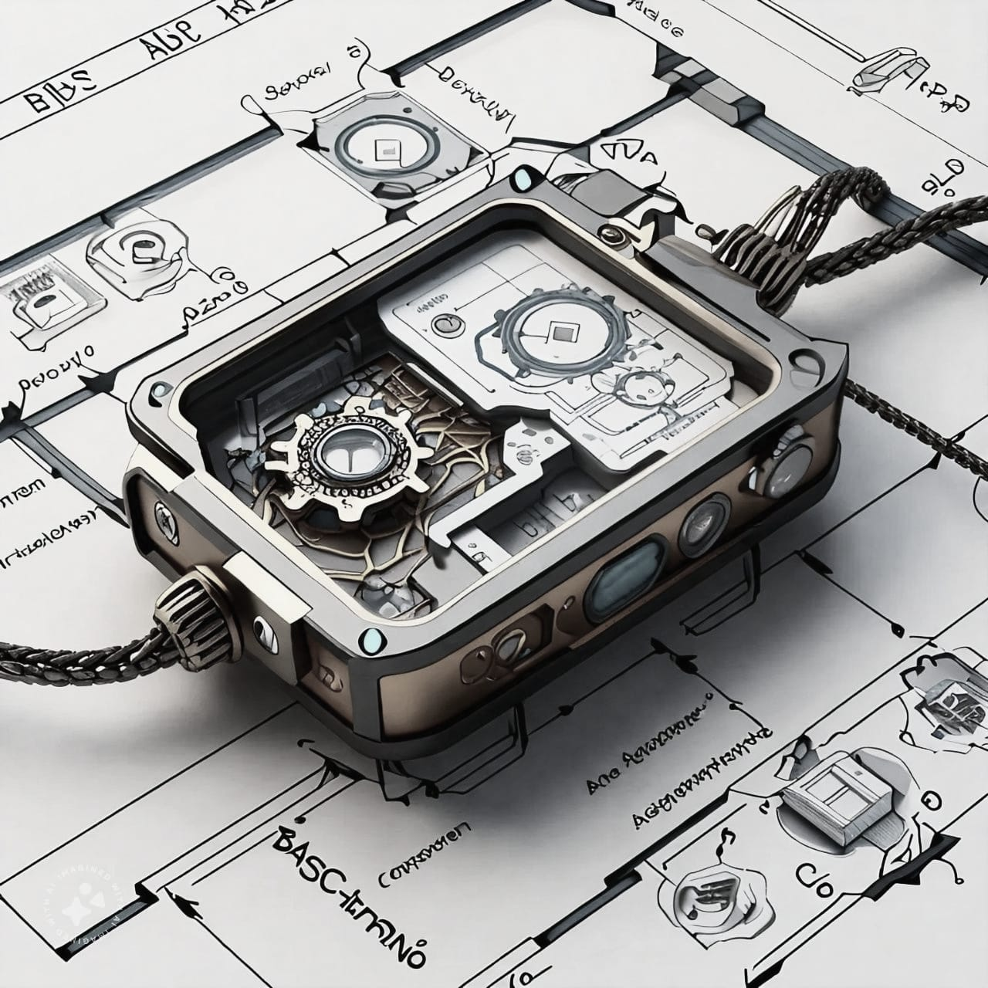
SENSOR
DETECTOR
GPS TRACKER
ACTIVATION SWITCH
SMART WATCH

Slide 4
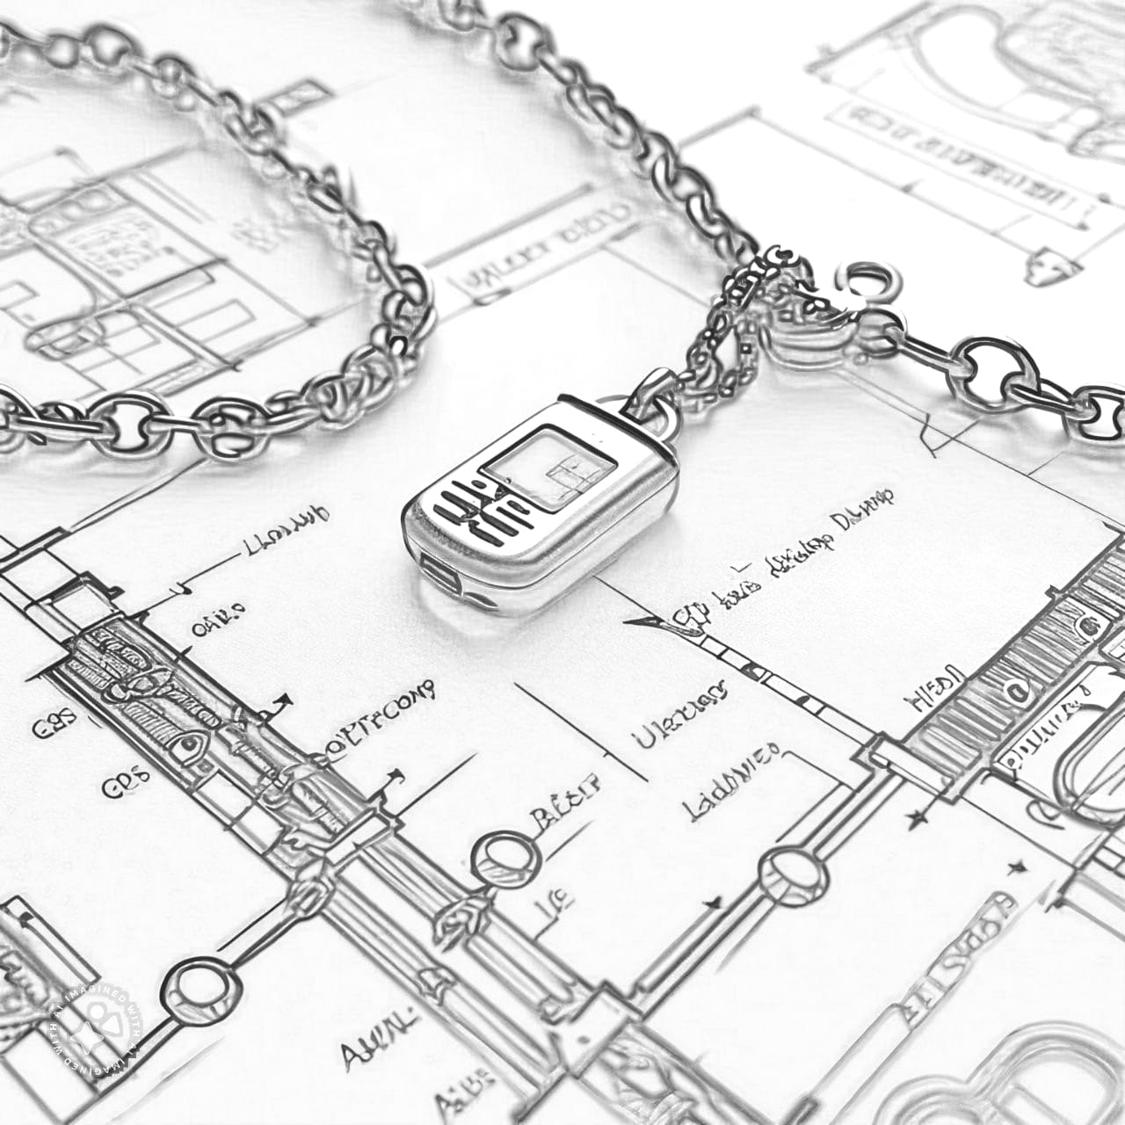
DETECTOR
SENSOR
GPS TRACKER
ACTIVATION SWITCH
BRACELETS OR CHAINS

Slide 5
COMPONENTS
ACTIVATION SWITCH :
The activation switch is a physical or software-based control that powers the device on or off, or activates certain features.
Types of Activation Switches:
Physical Button: A side button on the wristband that can be long-pressed to turn the device on or off, or to activate specific modes (like SOS or workout mode).
Touch Activation: Some smart wristbands use a touch-sensitive area of the screen for activation, allowing the user to tap or swipe to wake the device or start a function.
Gesture Control: Advanced wristbands may use motion or gesture-based activation, like lifting the wrist to wake the screen or twisting it to activate specific actions.
Voice Activation: If the wristband has a microphone, it may also support voice commands to activate features (such as starting a workout or calling for help).

Slide 6
2. Detector:
Purpose: The detector in a smart wristband typically refers to sensors that detect physiological data or environmental factors.
Types of Detectors:
Heart Rate Detector: Uses optical sensors to monitor blood flow under the skin, providing heart rate data.
Motion Detector: Utilizes an accelerometer and gyroscope to detect movement, steps, and activity type (walking, running, etc.).
Fall Detector: Senses sudden changes in motion or orientation, alerting for potential falls, often used for elderly users. Temperature Detector: Measures the skin’s surface temperature to monitor fluctuations and detect fevers or abnormal temperature changes.

Slide 7
3. GPS Tracker:
Purpose: A GPS tracker in a smart wristband is used to monitor the wearer’s location in real-time, whether for fitness tracking or safety purposes.
How It Works: The wristband receives signals from multiple satellites to calculate the exact location of the user.It allows tracking of outdoor activities like running, hiking, or cycling without needing a connected smartphone. Some advanced wristbands use AGPS (Assisted GPS), which combines satellite data and cellular networks to improve accuracy and reduce the time to acquire location information. Geofencing : GPS trackers can also set virtual boundaries, sending alerts if the user moves outside a defined area.
Battery Consideration: Continuous GPS usage drains the battery quickly, so it’s often enabled only during specific activities.

Slide 8
THANK YOU!!!
SUBMITTED BY : AKSHAJK C S SWATHY ANJANA K R ANGITHA C L GAWTHAM KRISHNA ELFREDSEBASTIAN

